Slide 1


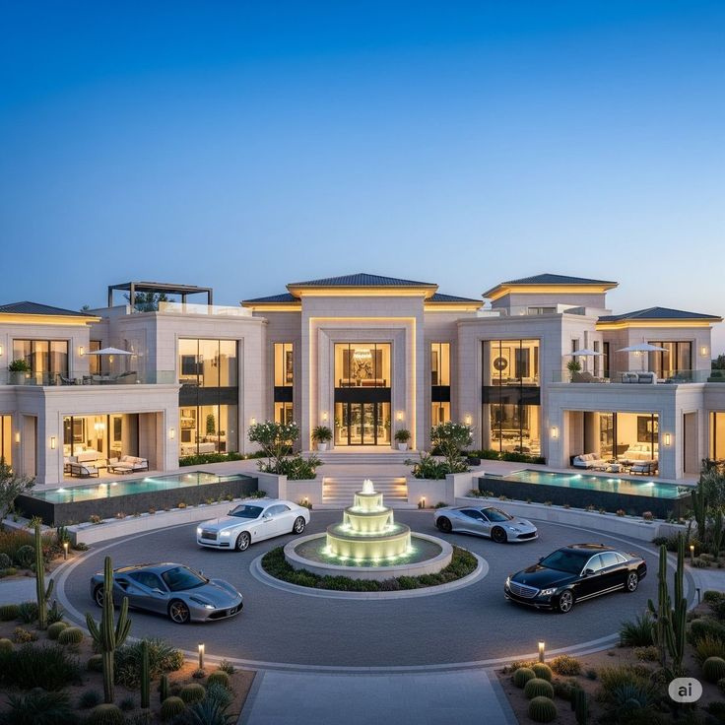
ARCHINOVA
SMART ARCHITECTURE DESIGN & INNOVATION RECOMMENDATION SYSTEM
Submitted by: Sathyavani.S & J.Livince Mary
Guide: Keerthana

Slide 2
SYSTEM OVERVIEW
What is Archinova?
Archinova is a smart web platform for architecture design selection.
It recommends building designs based on:
Budget
Area & floors
Climate / region
Style preference
Provides sustainability + interior suggestions.

Slide 3
User Interaction Flow
User opens website
User registers / logs in
User enters requirements:
Building type (Villa/House/Apartment)
Budget, area, floors
Style preference
Region (hot/cold/coastal/rainy)

Slide 4
RECOMMENDATION PROCESS (WORKING STAGE)
System Working Flow
System validates user input
Best matching designs are selected.
Recommendation engine processes data using:
Budget-based filtering
Climate-based analysis
Similar design matching

Slide 5
OUTPUT & FEATURES (RESULT STAGE)
Final Output to User
User receives:
Recommended building designs
Floor plan + elevation preview
Material suggestions based on climate
Sustainability ideas (solar, rainwater harvesting)
Interior & lighting recommendations
3D visualization (rotate/zoom)

Slide 6
ADMIN MODULE
Admin can:
Add / update designs in gallery
Manage users
Update recommendation rules
Monitor feedback and ratings
Maintain system database

Slide 7
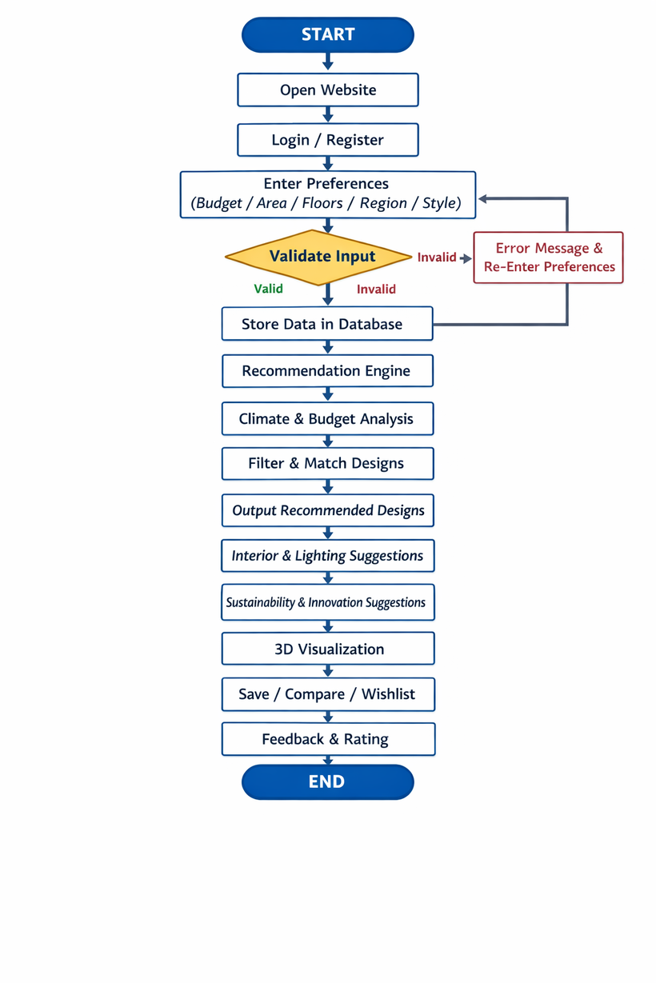
USER FLOW

Slide 8
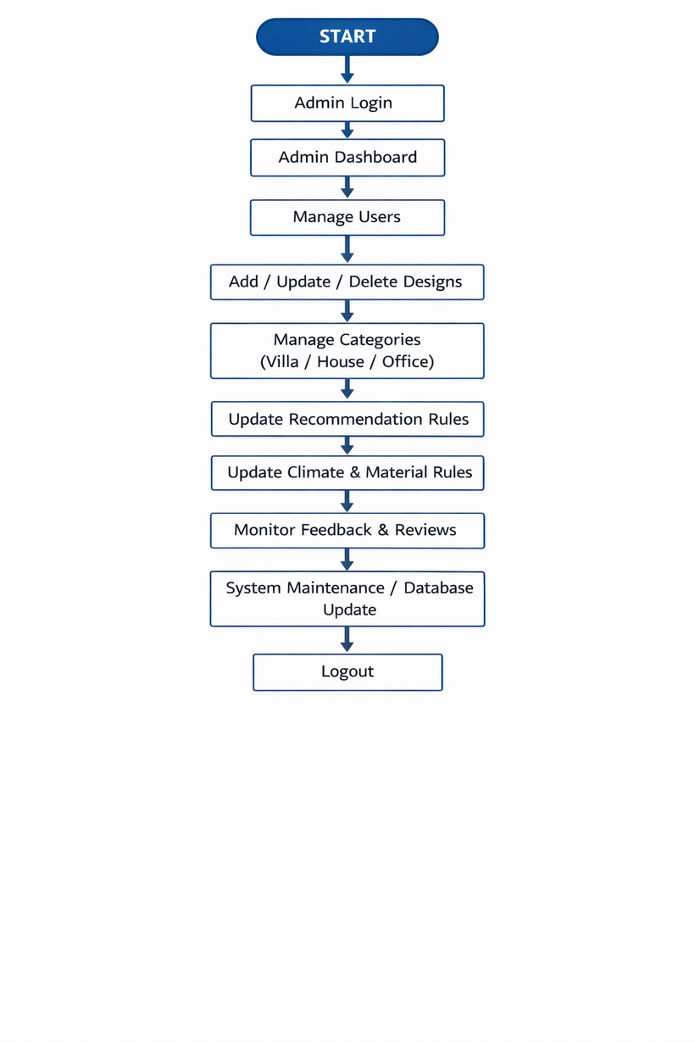
ADMIN FLOW

Slide 9
THANK
YOU

